Slide 1
An Epidemiological Review of Depression in Older Adults
Kelsey Taylor

Slide 2
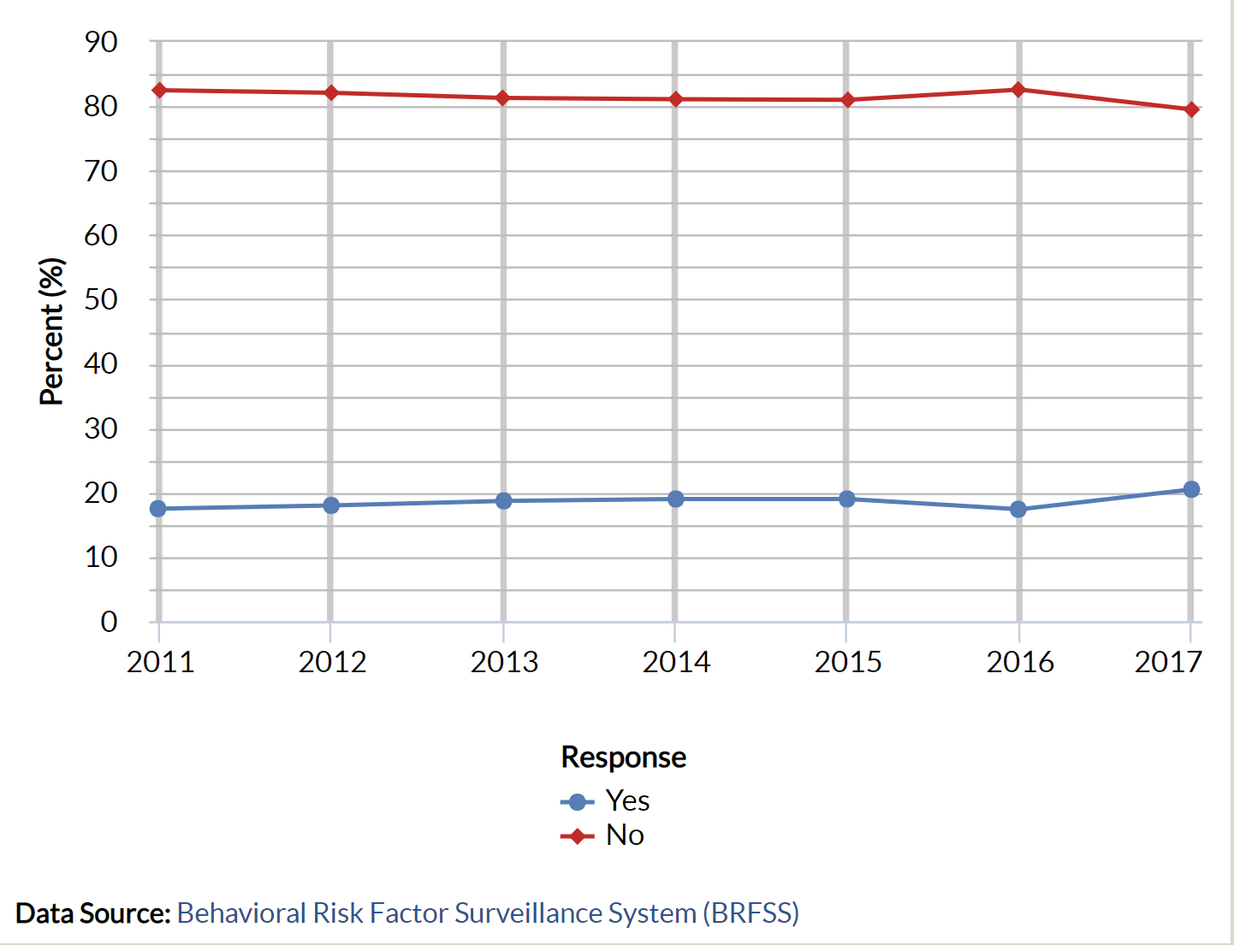
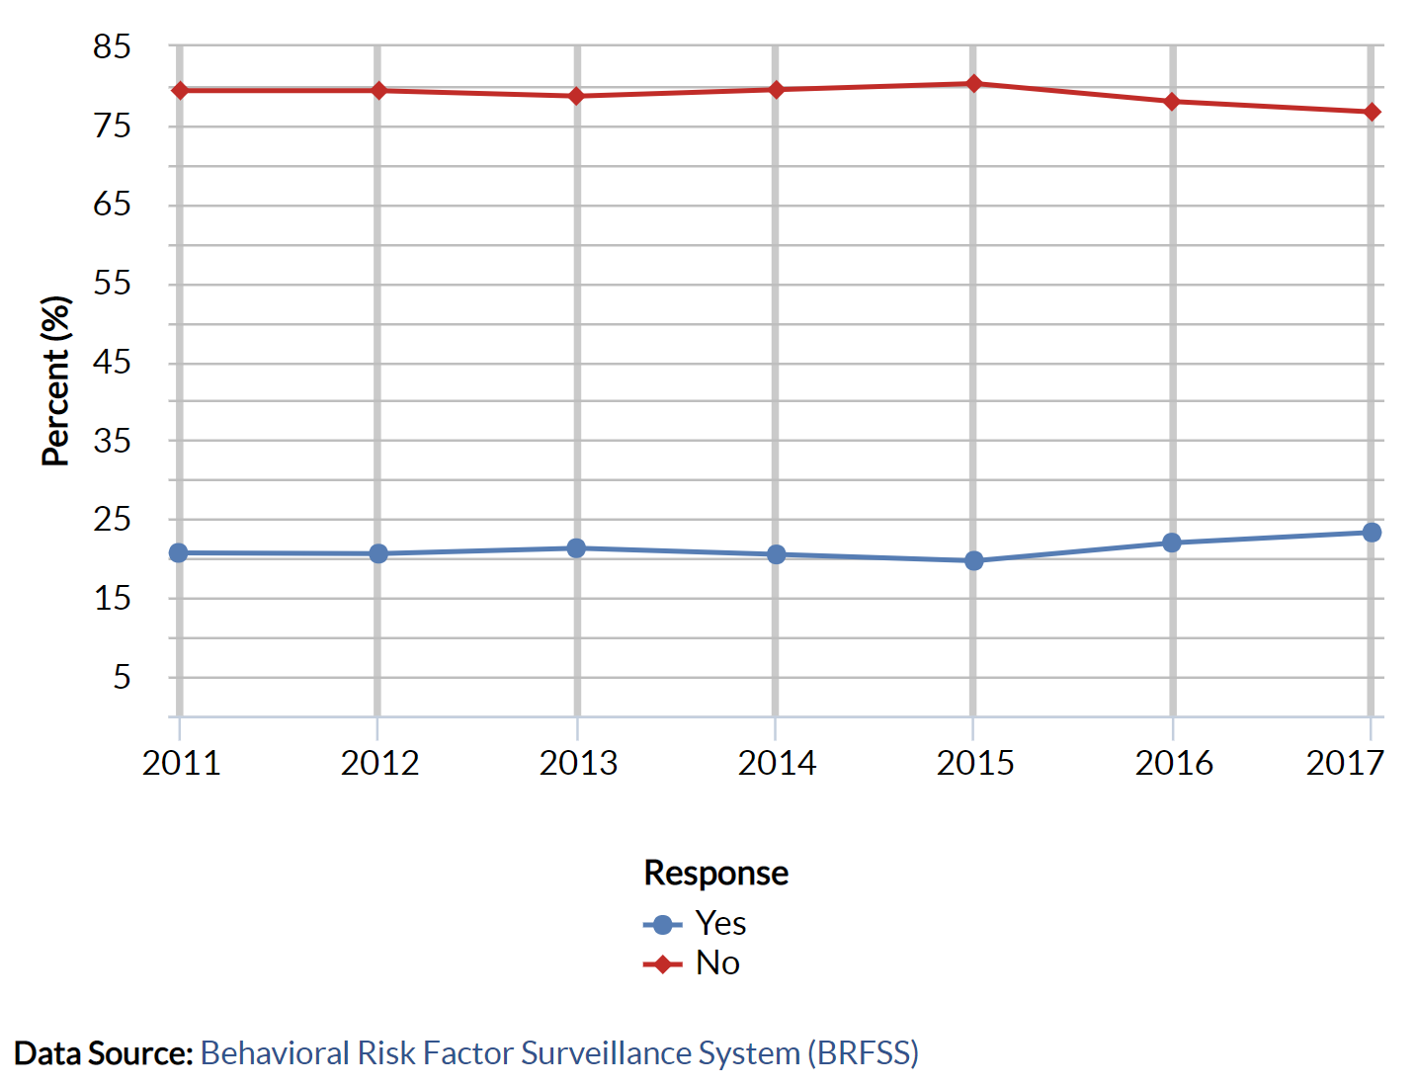
Adults 18-65+ Reporting Depression, U.S. and Michigan, 2011-2017
United States
Michigan
Notes:
In 2011 17.5% of adults 18 and older have ever been told they have depression. In 2017 there was increase to 20.5%, this is a 17% increase in adults that have ever been told they have depression from 2011-2017
For Michigan, in 2011 there were 20.7% people that have ever been told they have depression, and in 2017 it was 23.3%, this is a 12.5% increase from 2011-2017
US has higher percent increase, but Michigan has higher rates.
BRFSS

Slide 3
Percent ever told they have a form of depression by age, Michigan 2017
BRFSS 2018
Notes:
Looking at depression rates by age in Michigan, In 2017 24.2% of adults 55-64, and 19% of adults 65+ reported depression in Michigan
The age group of 25-34 is the highest, with ages 45-64 are the second highest.
65+ which is the group we are looking at are among the lowest, however its still almost at 20%, which is 1 out of 4 of older adults 65+ that are depressed
BRFSS

Slide 4
Percent of older adults reporting depression in Michigan 2011-2017
Behavioral Risk Factor Surveillance System (BRFSS)
Notes:
Depression is increasing in Michigan. In 2011, adults 55-64 were at 22.9% and in 2017 it went up to 24.2% which is a 5.6% increase
And adults 65+ were at 14.1% in 2011 and increased to 19% in 2017 which is a 34% increase

Slide 5
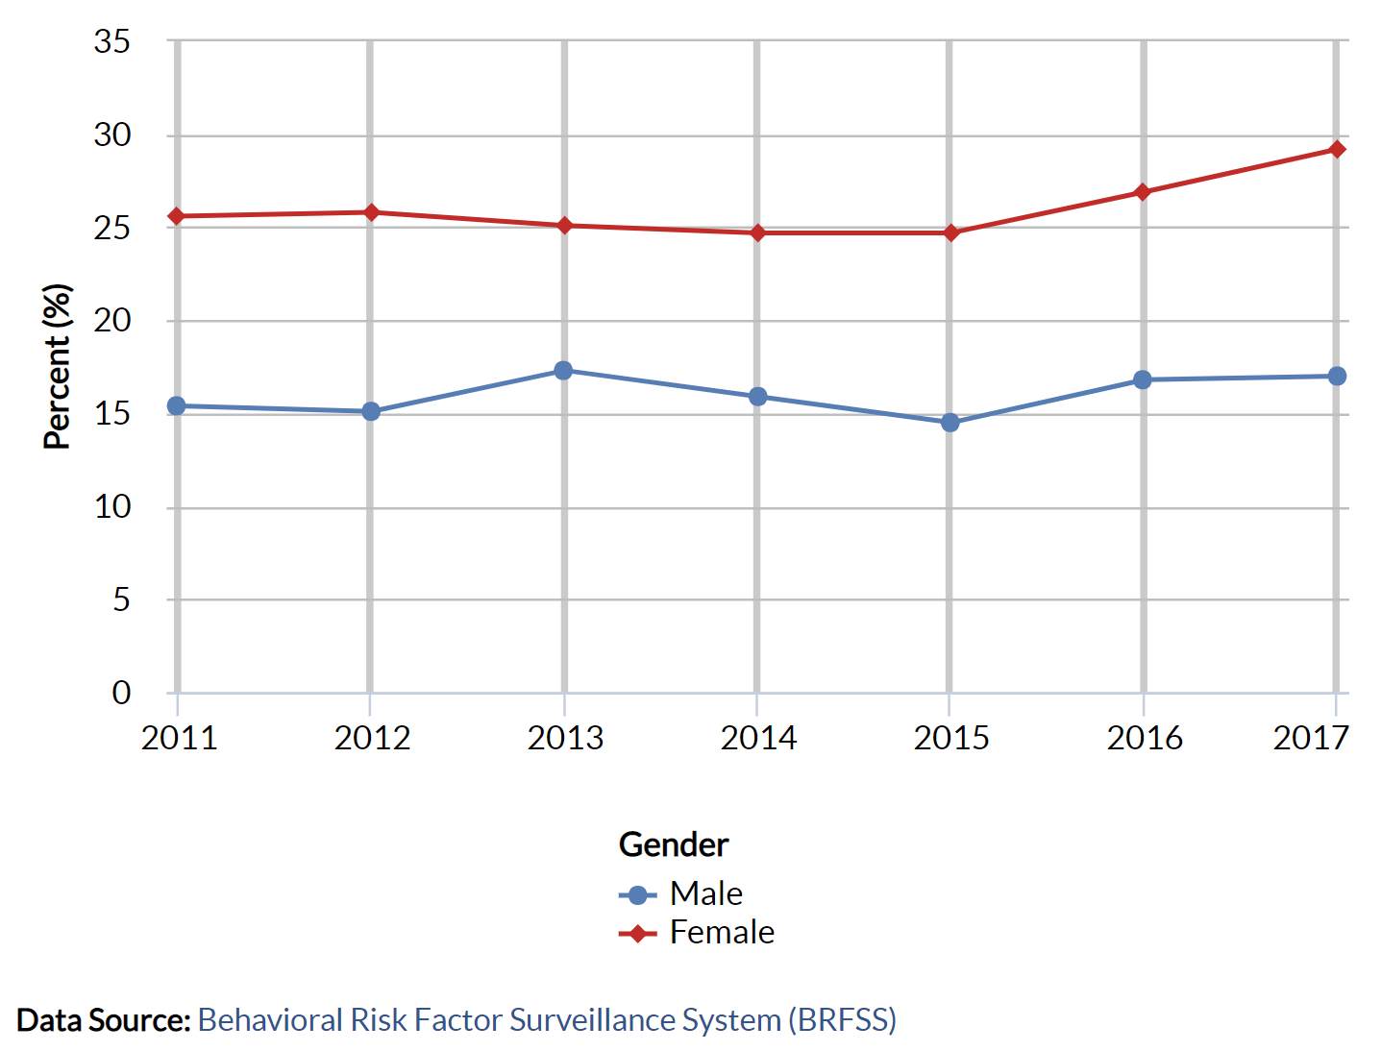
Depression in adults by Gender, Michigan 2011-2017
Notes:
Looking at the differences in Depression rates between the gender, we can see females (red) have a higher rate of depression than males (blue).
In 2011 15.4% of the males in Michigan have ever been told they have depression. In 2017 it was 17% which is a 10.3% increase
In 2011 25.6% of women in Michigan have ever been told they have depression. In 2017 it was 29.2% which is a 14% increase
Notably, there was an increase of 18% from 2015 to 2017 in females and 17% increase from 2015-2017 in males

Slide 6
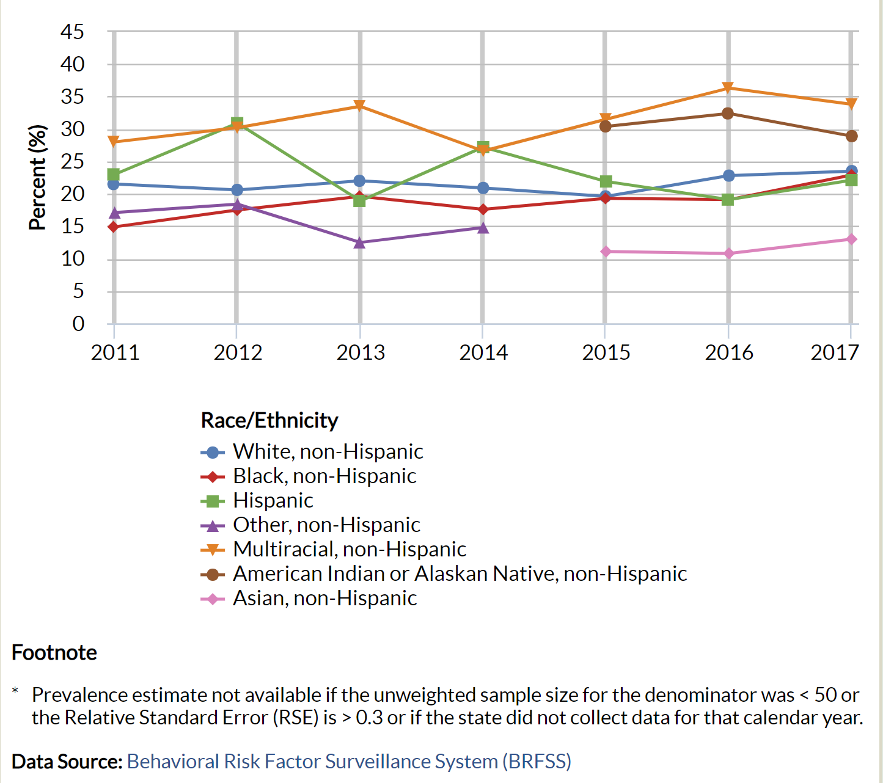
Adults18-65+ Reporting Depression by Ethnicity in Michigan, 2011-2017
Notes:
Then we look at Depression in Ethnicity, again, this is adults that have ever been told they have a form of depression.
At the top, we have the Multiracial group at 33.8% followed by American Indian/Alaskan Native at 28.9% There was only enough data on this group to report on them for the last two years.
Same with Asians down below in pink who are at the lowest with 13%. Before that, there was this Other, non Hispanic group in purple.
In the middle, we have the white, black, and Hispanic population all grouped together at around 23%
The Multiracial group is steadily at the top.

Slide 7
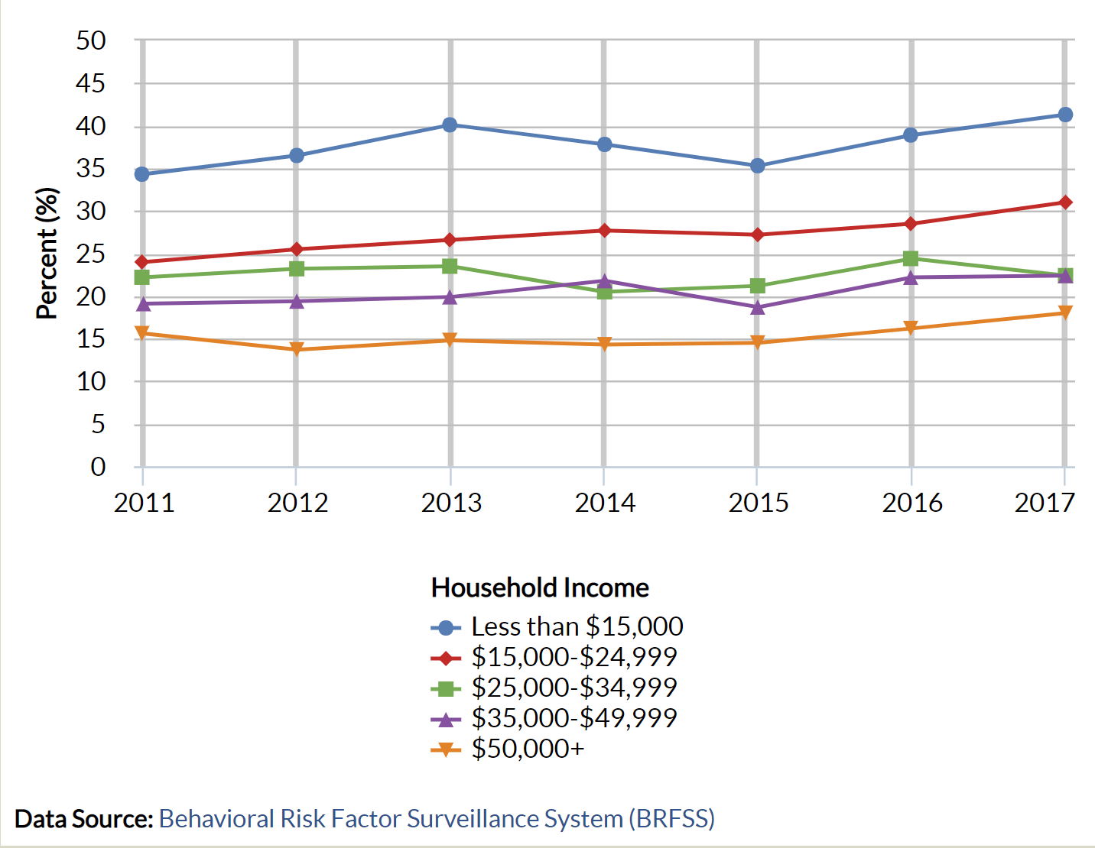
Adults Reporting Depression in Michigan by Income, 2011-2017
Notes:
This shows the linear relationship between income and depression, and it’s quite obvious.
Below 15K are the highest percent of people that have ever been told they have depression, in 2017 this group was at 41%
Next highest is the 15-24,999 in 2017 at 31%
In 2017 the groups between 25k and 50k were the same with 22%
And Finally, those who make 50k+ have the lowest percent of depression at 18%

Slide 8
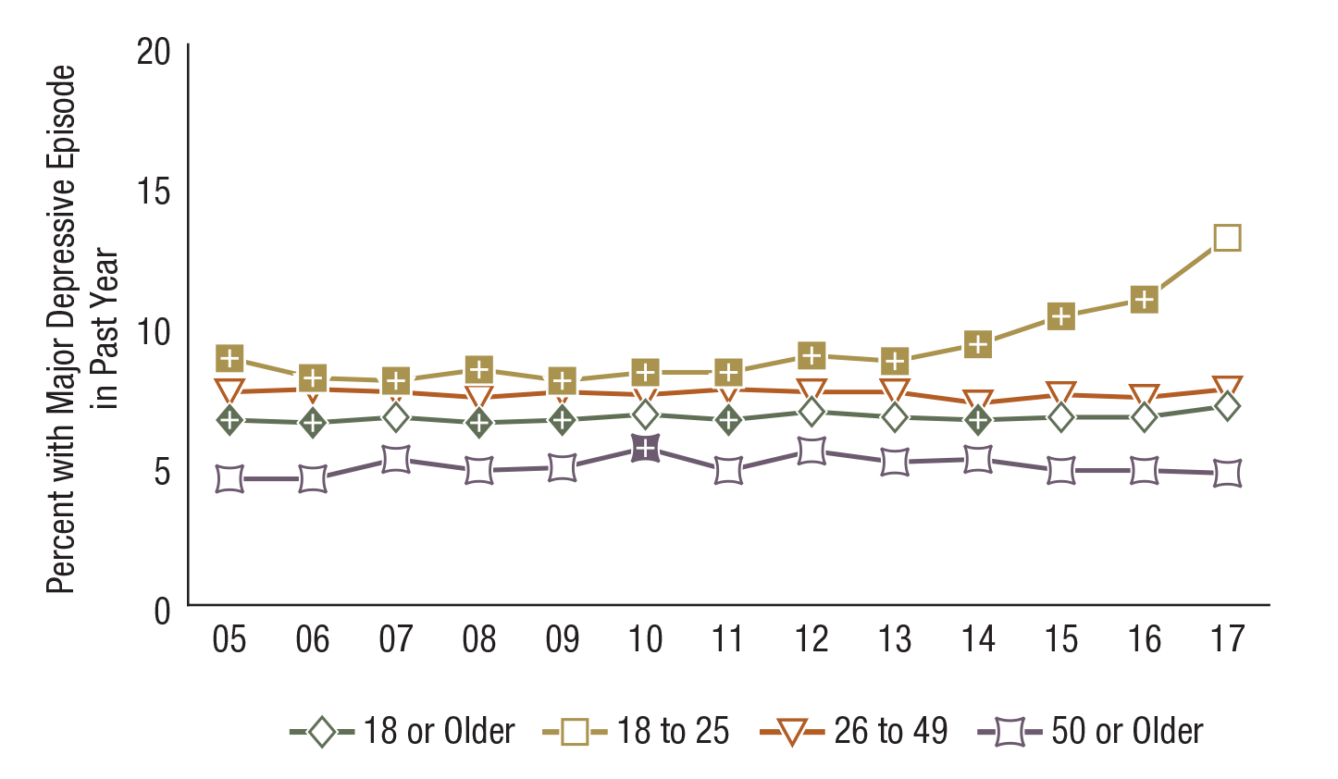
Major Depressive Episode in the Past Year among Adults Aged 18 or Older, by Age Group: Percentages, 2005-2017 USA
FFR1.45
Age Group | 2005 | 2006 | 2007 | 2008 | 2009 | 2010 | 2011 | 2012 | 2013 | 2014 | 2015 | 2016 | 2017
18 or Older | 6.6⁺ | 6.5⁺ | 6.7 | 6.5⁺ | 6.6⁺ | 6.8 | 6.6⁺ | 6.9 | 6.7 | 6.6⁺ | 6.7 | 6.7 | 7.1
18 to 25 | 8.8⁺ | 8.1⁺ | 8.0⁺ | 8.4⁺ | 8.0⁺ | 8.3⁺ | 8.3⁺ | 8.9⁺ | 8.7⁺ | 9.3⁺ | 10.3⁺ | 10.9⁺ | 13.1
26 to 49 | 7.6 | 7.7 | 7.6 | 7.4 | 7.6 | 7.5 | 7.7 | 7.6 | 7.6 | 7.2 | 7.5 | 7.4 | 7.7
50 or Older | 4.5 | 4.5 | 5.2 | 4.8 | 4.9 | 5.6⁺ | 4.8 | 5.5 | 5.1 | 5.2 | 4.8 | 4.8 | 4.7
NSDUH National Report 2017
Notes:
The next few slides are from the National Survey of Drug use and Health. This is an annual survey of the civilian, noninstitutionalized population of the United States aged 12 years old or older. The survey is sponsored by SAMHSA (Substance abuse and mental health services administration).
In 2017, 68,032 completed interviews were obtained, 50,999 of them from adults aged 18 or older.
Adults aged 18 or older were defined as having had at least one Major Depressive Episode in the past 12 months if they had a period of 2 weeks or longer in that period when they experienced a depressed mood or loss of interest or pleasure in daily activities, and they had at least some additional symptoms, such as problems with sleep, eating, energy, concentration, or self-worth.
In 2017, an estimated 5.2 million adults aged 50 or older had an MDE over the past year which is 4.7% of adults in this age group.
As you can see, for the age group 18-25 it has been both increasing, and statistically significant every year aside from 2017.
For the 50+ group, we have to look back to 2010 for statistically significant increase.
NSDUH National Report 2017

Slide 9
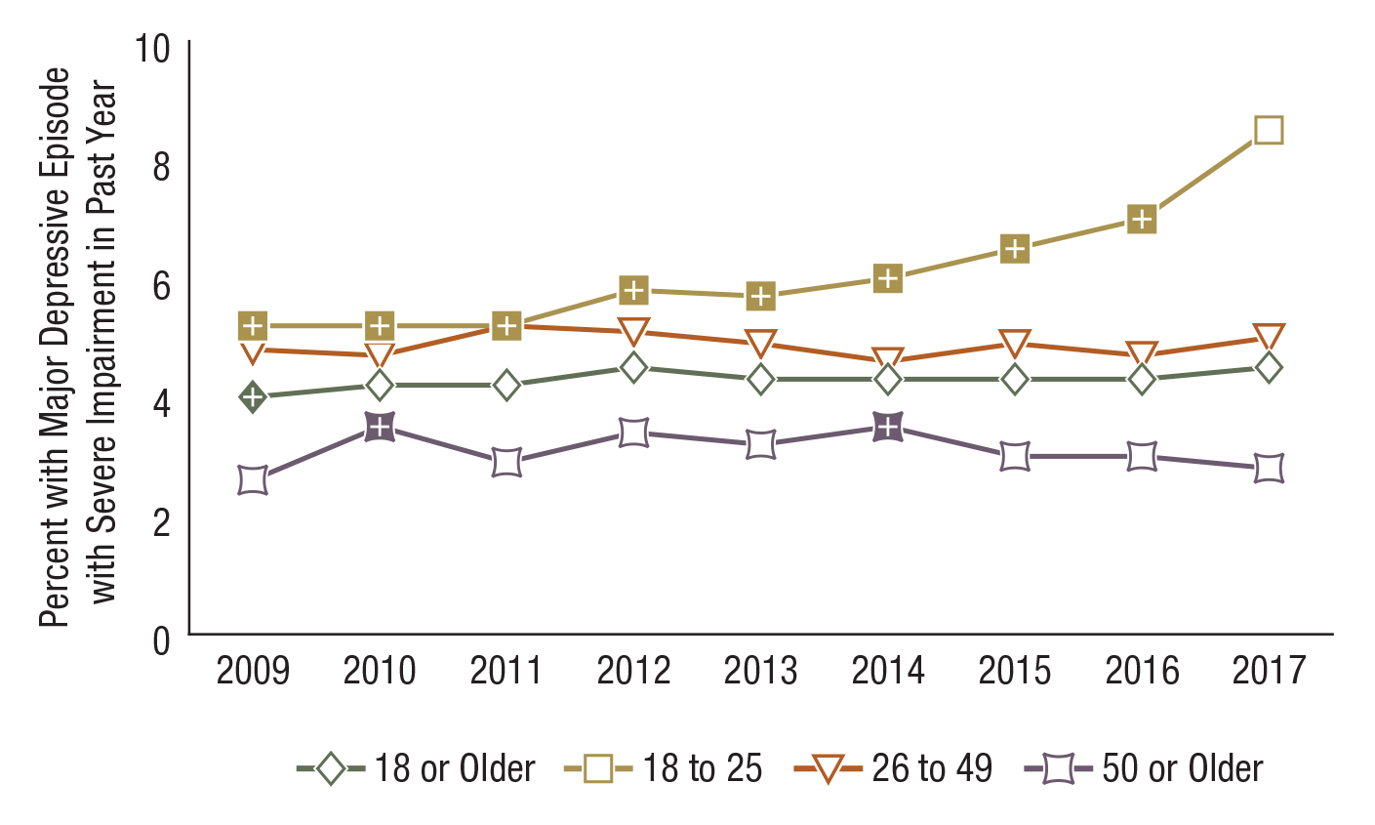
Major Depressive Episode with Severe Impairment in the Past Year among Adults Aged 18 or Older, by Age Group: Percentages, 2009-2017 USA
FFR1.46
Age Group | 2009 | 2010 | 2011 | 2012 | 2013 | 2014 | 2015 | 2016 | 2017
18 or Older | 4.0⁺ | 4.2 | 4.2 | 4.5 | 4.3 | 4.3 | 4.3 | 4.3 | 4.5
18 to 25 | 5.2⁺ | 5.2⁺ | 5.2⁺ | 5.8⁺ | 5.7⁺ | 6.0⁺ | 6.5⁺ | 7.0⁺ | 8.5
26 to 49 | 4.8 | 4.7 | 5.2 | 5.1 | 4.9 | 4.6 | 4.9 | 4.7 | 5.0
50 or Older | 2.6 | 3.5⁺ | 2.9 | 3.4 | 3.2 | 3.5⁺ | 3.0 | 3.0 | 2.8
NSDUH National Report 2017
Notes:
Along with MDE, there is also MDE with severe impairment. Adults were defined as having an MDE with severe impairment if their depression caused severe problems with their ability to manage at home, manage well at work, have relationships with others, or have a social life.
An estimated 3.1 million adults aged 50 or older in 2017 had a past year MDE with severe impairment, or 2.8% of adults in this age group
The percentage of adults aged 50 or older had statically significant increases in both 2010 and 2014
NSDUH National Report 2017

Slide 10
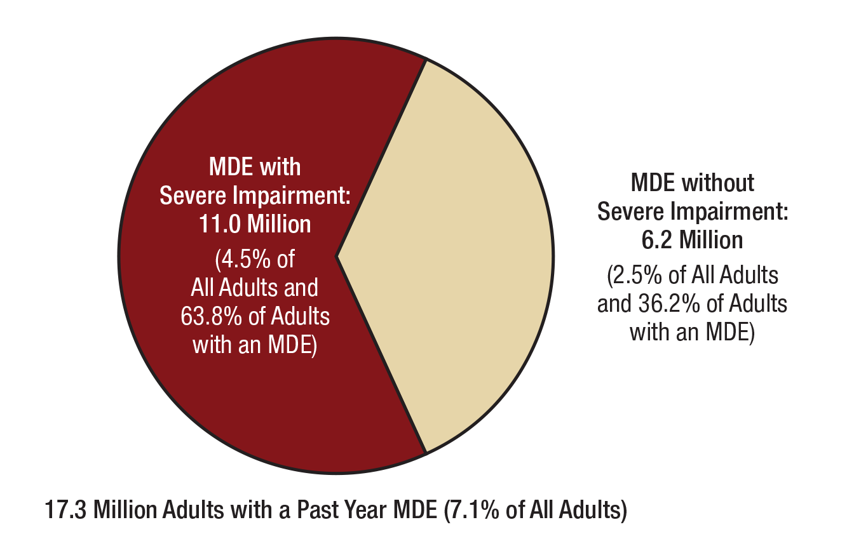
Major Depressive Episode (MDE) and MDE with Severe Impairment in the Past Year among Adults Aged 18 or Older: 2017
FFR1.44
NSDUH Annual National Report 2017
Note: Adult respondents with unknown past year MDE data or unknown impairment data were excluded.
Notes:
In 2017, 7.1% of adults aged 18 or older (17.3 million adults) had at least one MDE in the past year, and 4.5 percent of adults (11.0 million adults) had an MDE with severe impairment in the past year. Adults in 2017 who had an MDE with severe impairment represented nearly two thirds (63.8 percent) of adults who had a past year MDE.
NSDUH National Report 2017

Slide 11
Risk and Protective Factors for Depression

Slide 12
Does depression increase the risk for dementia in Mild Cognitively Impaired Individuals?
International Journal of Geriatric Psychiatry
Notes:
This study is looking at how having depression symptoms in addition to an Mild Cognitive Impairment can progress to dementia. An MCI is defined by the objective impairment of one or more cognitive domains, with no or minimal impairments of the performance on instrumental activities of daily living and no global cognitive impairment.
This study was a meta analysis, and they found that the pooled RR of progressing to dementia is 28% higher in MCI subjects with depressive symptoms compared to those without depressive symptoms.
What’s really important is to note that higher depressive symptoms increases the risk of progression from MCI to dementia, suggesting that depressive symptoms can be considered a genuine risk instead of just a behavioral reaction to the progressive cognitive decline in older adults.
The study showed that subjects with MCI and depression have a greater risk of progressing to dementia upon follow up.
The authors noted that there is a need for studies aiming to treat depression in subjects with MCI and to evaluate whether depression treatment can reduce the risk in these individuals.
International Journal of Geriatric Psychiatry

Slide 13
Does MCI or Dementia increase risk for Depression?
AM J Geriatr Psychiatry, 2015
Notes:
While the last slide looked at depression as a risk factor for dementia, this one will look at how MCI or Dementia is a risk factor for Depression.
In this study, subjects without depression in the beginning of the study, but had MCI or Dementia, had a higher probability of a depression diagnosis within 2 years compared to those with normal cognition.
MCI and dementia were associated with significantly higher rates of depression in concurrent as well as prospective analyses.
There is a strong contemporaneous (at the same time) relationship between cognition status and depression, with both dementia and MCI patients approximately 2.5 times more likely to have depression. Again, this shows a need to treat co-occurring depression.
AM J Geriatr Psychiatry, 2015

Slide 14
Depressive Symptoms according to tertials of Sedentary Behaviors
Mayo Clin Proc. 2015 February
Notes:
Controlling for age, gender, education, marital status, employment status, current smoker, BMI and diabetes; this study shows that the longer the time spent riding in a car, viewing TV, and combining those behaviors were associated with higher risk of developing depressive symptoms over an average period of 9.3 years, and these associations remained significant, after adjustment for other covariates, including MVPA (moderate/vigorous physical activity).
For those who rode in a car for more than 9 hours a week were 1.27 more likely to have depressive symptoms compared to those who were in the car less than 5 hours.
Those who watched more than 10 hours of TV a week were 1.42 times more likely to have depressive symptoms compared to those who watched less than 5.
On the high end, in the red, those who had a combined car riding and TV watching hours of more than 19 per week had 1.63 times more likely to have depressive symptoms
The group who had between 12-18.9 combined hours were 1.31 times more likely than those whose combined sedentary behaviors were less than 12 a week.
Mayo Clin Proc. 2015 February

Slide 15
Stressors presented by depression at a 3 year follow up in older women
Social Psychiatry and Psychiatric Epidemiology
Notes:
The subjects for this study that are on the next few slides are a group of 91,912, community-dwelling, post-menopausal women, and they measured depression
Depression in the previous week was assessed at baseline and at the three year follow-up using a modified 6-item version of the Center for Epidemiologic Studies Depression Scale. Scores ranged from 0 to 18, with 18 representing more symptoms.
They found out that stressors at baseline, including verbal abuse, physical abuse, caregiving, social strain, negative life events, financial stress, low income, acute pain, and a greater number of chronic medical conditions, were all associated with higher levels of depression symptoms, and elevated symptoms at 3-year follow-up.
Physical abuse over the past year was assessed via a yes/no question: “Were you physically abused by being hit, slapped, pushed, shoved, punched, or threatened with a weapon by a family member or close friend? Those who answered yes were almost 2times more likely to have depression than those who did not.
Verbal abuse was assessed similarly, and those who reported yes were 1.78 times more likely than those who did not experience verbal abuse.
Caregiving was assessed by asking “Are you now helping at least one sick, limited, or frail family member or friend on a regular basis?” They were asked to say how many days per week they helped, and those that said 3 or more times a week were 1.42 times more likely to be depressed than those who reported 2x a week or less.
4 questions were asked to determine social strain “Of the people who are important to you, how many…” “get on your nerves?” “ask too much of you?” “do not include you?” and “try to get you to do things you don’t want to do?” Total scores could range from 4 (no social strain) to 20 (high social strain). Those who reported high social strain were 1.46 times more likely to have depression than those who reported low social strain.
Social support and physical activity were associated with lower levels of depressive symptoms which is on an upcoming slide.
Social Psychiatry and Psychiatric Epidemiology

Slide 16
Acute Life Events as risk factor for depression
Social Psychiatry and Psychiatric Epidemiology
Notes:
The same study assessed Interpersonal life events over the past year. The participants were asked a series of yes/no questions regarding death of a spouse or partner, serious illness in a spouse or partner, serious illness or death of a close friend or family member, divorce or break-up with a spouse or partner, divorce or break-up for a family member or close friend, and major conflict with children or grandchildren.
Those who experienced 1 negative major life event was 1.2 times more likely to have depression compared to those who didn’t have any. Close is 2 events at 1.28 times.
Those who experienced 3 or more were almost 2times more likely to have depression than those who didn’t experience any.
Social Psychiatry and Psychiatric Epidemiology

Slide 17
Acute financial stress as risk factor for depression
Social Psychiatry and Psychiatric Epidemiology
Notes:
Financial stress in the past year was assessed with the question: “Did you have major problems with money?” and Annual Income.
Those who said “yes: were almost 2times as likely to have depression than those who said no.
Also, those with an income at 20k or less were almost 2times as likely to have depression compared to those whose income was 50k or more.
Those making 20-49k were at 1.3 times more likely than those at 50k or more.
Social Psychiatry and Psychiatric Epidemiology

Slide 18
Chronic conditions as risk factor for depression
Social Psychiatry and Psychiatric Epidemiology
Notes:
Chronic conditions were assessed by asking “Has a doctor ever told you that you have any of the following conditions or have you had any of the following procedures?” Participants could mark as many as applied. The list included 29 different common medical problems, such as heart problems, arthritis, hypertension, or cancer.
Compared to those who did not have any chronic conditions, those with 1 were at 1.24 times more likely to have depression, those with 2 were at 1.32 and those with 3 or more chronic conditions were twice as likely to have depression than those with no chronic conditions.
Social Psychiatry and Psychiatric Epidemiology

Slide 19
Protective Factors against Depression in Older Adults
Social Psychiatry and Psychiatric Epidemiology
Notes:
The same study found protective factors, as I mentioned earlier.
Social support was assessed with emotional/informational, affection, tangible, and positive social interaction.
To assess social support, they used 9 items from the Medical Outcomes Study social support questionnaire. Scores could range from 9 to 45, with higher scores reflecting more social support. Those who experienced more social support had a 28% decreased risk of being depressed than those with low scores.
To assess physical activity, women were asked how often they walked outside the home for more than 10 min and at what speed, as well as how often and for how long they engaged in strenuous, moderate, and mild exercise. Women were asked to estimate minutes per week. The results were summarized into a continuous variable estimating total weekly energy expenditure. Those with high weekly energy expenditure had a 4% decreased risk of depression than those with low.
Social Psychiatry and Psychiatric Epidemiology

Slide 20
Longitudinal association between physical, social, religious activity and risk of depression
PLOS ONE, July 14, 2015
Notes:
This study looked at elderly subjects 60 or older in Korea, and how physical, social, and religious activity decreases the risk of depression.
Those who participated in physical activity 3 or more times a week were 19% less likely to have depression than those who participated less than 3 times a week.
Those who participated in religious activity once or more a week were 22% less likely to have depression than those who did less than once a week.
Those who participated in tow or three types of activity frequently were 36% less likely to have depression than those who had no frequent physical, social or religious activity and those who just had one type of frequent activity were still at 14% decreased risk.
PLOS ONE, July 14, 2015

Slide 21
Fish Consumption and decreased risk of depression
J Epidemiol Community Health 2015
Notes:
Another study found protective factor in fish consumption.
There was an overall significant inverse association between fish consumption and depression. A significant association was observed in cohort studies as well as in cross sectional studies.
However, only among studies conducted in Europe, and not those in North America, South America, Asia, or Oceania. This is presumably from differences in fish type, fish preservation, and cooking styles.
Out of 26 studies, the pooled RR showed that those who had the highest consumption of fish had a 17% reduced risk of depression than those who had the lowest consumption.
J Epidemiol Community Health.

Slide 22
Fruit and Vegetable Intake and Depression
British Journal of Nutrition
Notes:
In this meta-analysis on eighteen studies, they found that high consumption of fruit, vegetables and total fruit and vegetables was significantly associated with reduced risk of depression (20%). They also found that every 100-g increase in the consumption of fruit or vegetables was associated with a 5% reduction in the risk of depression
In red we see that from 6 cohort studies showed the highest intake of fruit was associated with a 17% decreased risk of depression compared to the lowest.
The next bar represents 7 cohort studies which showed that high intake of vegetables was associated with a 14% decreased risk of depression compared to the lowest.
Finally, the meta analysis on 18 studies found that high consumption of fruits and veggies showed a 20% decreased risk of depression than those with low consumption.
British Journal of Nutrition

Slide 23
Healthy Diet pattern decreases risk of depression in…
Notes:
The western-style dietary pattern is mainly characterized by a high consumption of red and/or processed meat, refined grains, sweets, high-fat dairy products, butter, potatoes and high-fat gravy, and low intakes of fruits and vegetables.
Results of this study indicated that the healthy dietary pattern is associated with a decreased risk of depression, whereas the Western-style/unhealthy dietary pattern is associated with an increased risk of depression.
The risk of depression was more obvious for subjects older than 50 y/o on the western diet

Slide 24
Coffee as a protective factor for depression
Mol. Nutr. Food Res. 2016,
Notes:
There is more good news! Coffee serves as a protection factor against depression.
Keep in mind that there are 236ml in 1 cup
This was a meta analysis of twelve studies with 23 datasets, accounting for a total of 346 913 individuals and 8146 cases of depression.
Overall, higher coffee consumption had a protective effect against depression in all subgroups except when analyses were not adjusted for dietary variables or social isolation.
The study showed a peak of protective effect for 400 mL/day at 16% reduced risk of depression, same with 600mL/day, this is between 2-3 cups a day.
Even at 200mL there is a 11% decreased risk compared to no coffee and 12% on the higher end with 1000mL.
Mol. Nutr. Food Res. 2016,

Slide 25
Tea as a protective factor
Mol. Nutr. Food Res. 2016,
Notes:
A dose–response analysis per 500 mL/day increase of tea consumption suggested significant reduced risk of depression associated with tea consumption -caffeinated tea only showed a potential reduced risk of depression for increased intake of tea.
Ultimately The dose–response analysis for increase of 100 mg/day of caffeine resulted in significant reduced risk of depression
Mol. Nutr. Food Res. 2016,

Slide 26
Community Guide Recommended Best Practice
Home-based depression care management involves:
  Active screening for depression
  Measurement-based outcomes
  Trained depression care managers
  Case management
  Patient education, and a
  Supervising psychiatrist

Slide 27

PEARLS: Program to Encourage Active, Rewarding Lives
(PEARLS) is a national evidence-based program for late-life depression
Home Based
Skills Education
Screen
Treat
Notes:
Real life example is PEARLS:
PEARLS Program was developed by researchers at the University of Washington
PEARLS is accredited by the National Association of Social Workers
Focuses on teaching each client the skills necessary to move to action and make lasting life changes
Is delivered in the client’s home or other accessible community setting
Is designed to be delivered in the community through social service or other trusted community-based organizations
Takes a team-based approach, involving the PEARLS counselor, clinical supervisor, and health provider
Aims to improve quality of life, as well as reduce depressive symptoms
Is well-suited for individuals with chronic illness, including people with epilepsy
During six to eight sessions that take place in the client’s home and focus on brief behavioral techniques, PEARLS counselors empower individuals to take action and make lasting changes so they can lead more active and rewarding lives
Licensed Social Workers, Marriage, and Family Therapists and Mental Health Counselors are eligible to be PEARLS trained
To date, over 700 individuals from over 100 community-based agencies around the country have participated in PEARLS trainings.

Slide 28
Over 12 months, Individuals who received PEARLS were more likely than those who did not to…
JAMA. 2004
Notes:
The study was funded by the CDC and conducted as a collaboration between staff and faculty members from the University of Washington’s HPRC and managing, supervisory and clinical staff at Aging and Disability Services (ADS, the Seattle/King County Area Agency on Aging) and Senior Services of Seattle/King County.
The participants were: 138 clients aged 60 years or older who received community-based social services in metropolitan Seattle
4% had minor depression and 48.6% had dysthymia.
42% identified as a racial/ethnic minority
72% lived alone
58% had an annual income of less than $10,000
69% received a form of home assistance.
This study showed that over 12 months, individuals who received the PEARLS Program were more likely than those who did not receive PEARLS to:
Have a 50% or greater reduction in depression symptoms
Achieve complete remission from depression
Have greater health-related quality-of-life improvements in both functional and emotional well-being
Trend toward lower hospitalization rates
Moreover, the PEARLS Program study findings also support a model for community-based organizations to screen and effectively treat depressed, frail older adults using primarily non-pharmacological methods
JAMA. 2004

Slide 29
Summary
Depression rates are increasing
Females have higher rates of depression than males
1 out of 4 older adults are depressed
Of the people who had a major depressive episode in the last year, 2/3rds had severe impairment
Risk factors include: MCI/Dementia, sedentary behavior, abuse, social strain, financial issues, acute life events, chronic conditions
Protective factor include: physical activity, social support, religious activity, healthy diet, coffee

Slide 30
Questions
Thank you for listening

